Slide 1
System Software
Dr. Charles R. Severance
online.dr-chuck.com

Slide 2
Outline
Memory Controller
RAM, ROM, EPROM / Keyboard / Screen
Storage
BIOS
Operating System
Compiler
Interpreter
Emulator
WASM

Slide 3
From a CPU to a Computer

Slide 4


What
Next?
Generic
Computer
Software
Input
and Output
Devices
Central
Processing
Unit
Secondary
Memory
11100010
11101000
Main
Memory
Python for Everybody
Chapter 1
Slide 19
Machine
Language
Notes:
This slide is a block diagram of a computer showing a central processing unit connected to main memory. Software is loaded into the main memory. The software can also interact with input / output devices and secondary memory for long-term storage.

Slide 5
ROM
Keyboard
Central
Processing
Unit
Memory
Logic
Screen
RAM
Sound
I/O
Storage
ROM – Read Only Memory
RAM _ Random Access Memory
Network
Notes:
This slide is a block diagram of a computer showing a central processing unit connected to main memory. Software is loaded into the main memory. The software can also interact with input / output devices and secondary memory for long-term storage.

Slide 6
AI: Please show me the address map of the Apple 2
1981
+----------------------+ FFFF ┐
| Monitor ROM | │
| (last 2 KB) | │
+----------------------+ F800 │
| Applesoft BASIC ROM | │
| (8 KB) | │
+----------------------+ E000 │
| Integer BASIC ROM | │
| (early models only) | │
+----------------------+ D000 │
| I/O & "Soft" Switches| │
| C000–C0FF | │
| Expansion Slot ROM | │
| C100–C7FF (per slot) │
+----------------------+ C000 │
| Free RAM / Expansion | │
| varies by model | │
+----------------------+ A000 │
+----------------------+ A000 │
| Hi-Res Page 2 | │
| Graphics (8 KB) | │
+----------------------+ 9800 │
| Hi-Res Page 1 | │
| Graphics (8 KB) | │
+----------------------+ 8000 │ Graphics
| Text Page 2 | │
+----------------------+ 0400 │
| Text Page 1 | │ Video RAM
+----------------------+ 0200 │
| Zero Page & Stack | │
| | │
+----------------------+ 0000 ┘

Slide 7
AI: How do I make a click on the Apple II in 6502 Assembly?
Reading memory location $C030 toggles the speaker state
LDA $C030 ; One toggle = click

Slide 8
Read a Key on the Apple II
AI: How do I read the current pressed key on the apple II in 6502 assembly?
When a key is pressed, location $C000 holds the ASCII code with bit 7 set.
You must read $C010 after handling the key — this resets the “key ready” flag so the next keypress can be detected.
If bit 7 of $C000 is not set, no key is waiting.
GETKEY:
LDA $C000 ; Read keyboard
BMI GOTKEY ; If bit 7 = 1 → key is ready
BPL GETKEY ; Loop until key arrives
GOTKEY:
LDA $C000 ; Read the actual ASCII value
AND #$7F ; Strip the high bit (keep ASCII only)
STA $C010 ; Reset keyboard strobe
RTS ; Return with key in A

Slide 9
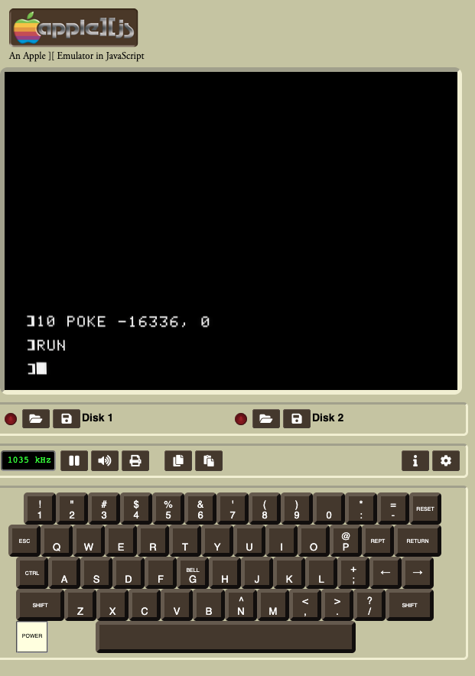
AI: How do I make a click sound in Apple Basic?
To make a click sound in AppleSoft BASIC, you just need to access the speaker soft-switch at memory location -16336 (which corresponds to $C030 in hex).
POKE -16336,0
https://www.scullinsteel.com/apple2/

Slide 10
AI: How do I make the whole screen white in the Apple 2 in 6502 Assembly?
; --- Set graphics + hi-res page 1 ---
LDA $C050 ; Graphics mode
LDA $C057 ; Hi-res mode
LDA $C054 ; Select Page 1
; --- Fill HGR Page 1 with $FF ---
LDA #$FF ; White pixel byte
LDY #0
LDX #0
FillLoop:
STA $2000,X ; Store byte in first page of hi-res memory
INX
BNE FillLoop ; Continue until X wraps to 0
INC FillLoop+2 ; (hack: increments high byte of address!)
BNE FillLoop ; Continue until reach $4000
RTS

Slide 11
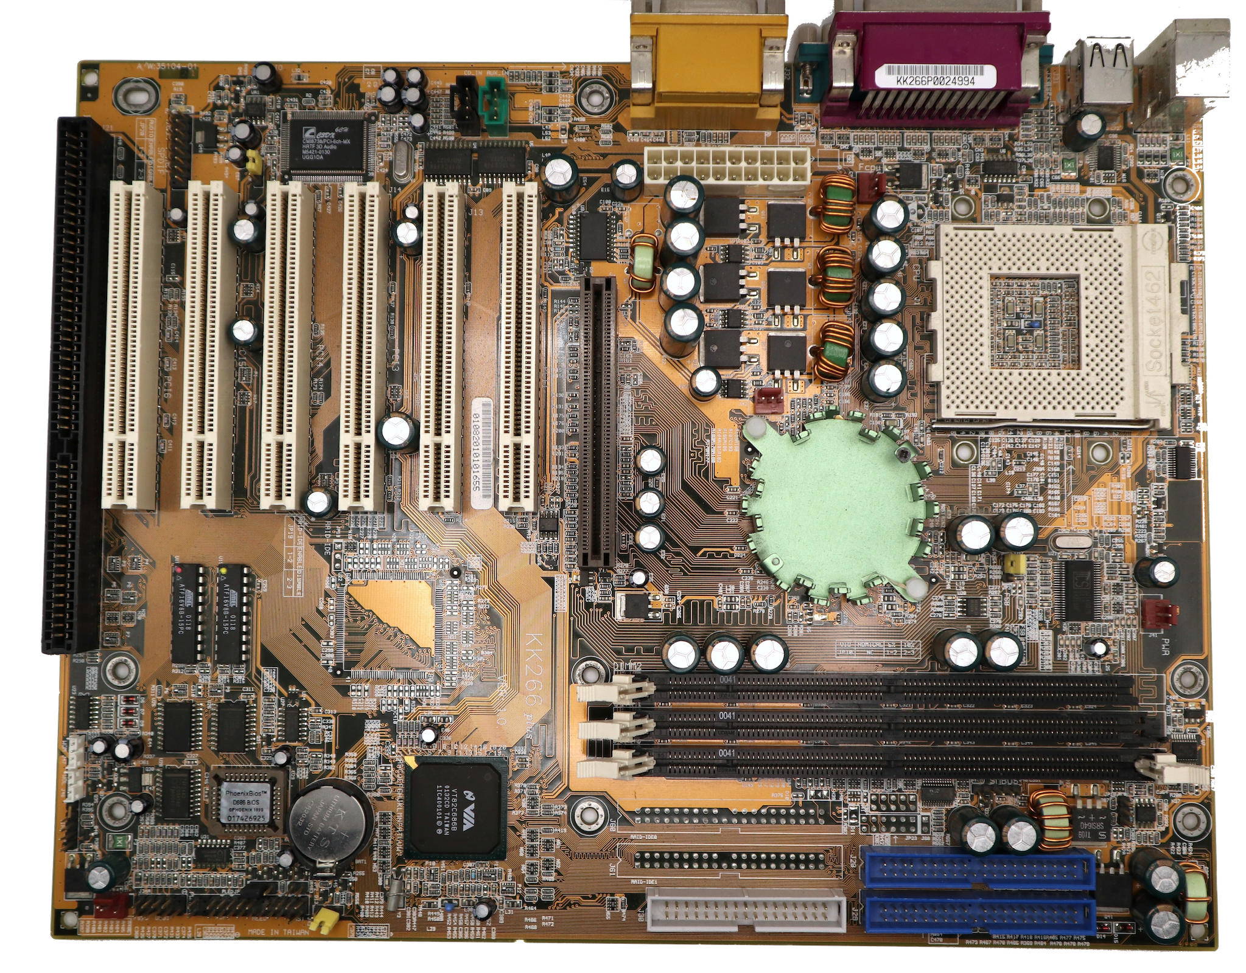
USB
Memory
Controller
North Bridge
CPU
Socket
Memory
Controller
South Bridge
RAM
Slots
ROM
BIOS
Disk
Connectors
2005

Slide 12
Read a Key on the IBM PC
AI: How do I read a key in x86 assembly using the original IBM PC BIOS?
; Check if key is waiting; ZF=1 if no key.
CHECKKEY:
MOV AH, 01h ; BIOS: Check Keyboard status (non-blocking)
INT 16h
JZ NO_KEY ; Zero flag set? No key available
; If key is available, read it:
MOV AH, 00h
INT 16h
NO_KEY:
RET

Slide 14
WASM – Web Assembly
There is a machine language emulator built into browsers called Web Assembly
For a wide range of software, compiling to WASM and running in JavaScript is enough
WASM is a different syntax than most Assembly languages – but it still compiles to a binary-machine code
C Programming for Everybody (www.cc4e.com) C Playground compiles C to WASM and then runs the WASM in the user's browser

Slide 15
WASM Hello World
;; Hello World WASM Example
(module
(import "console" "log" (func $log (param i32 i32)))
(memory 1)
(data (i32.const 0) "Hello, World!")
(func $main (result i32)
(call $log (i32.const 0) (i32.const 13))
(i32.const 42)
)
(export "main" (func $main))
)
00000000: 00 61 73 6d 01 00 00 00 01 0a 02 60 02 7f 7f 00 |.asm.......`....|
00000010: 60 00 01 7f 02 0f 01 07 63 6f 6e 73 6f 6c 65 03 |`.......console.|
00000020: 6c 6f 67 00 00 03 02 01 01 05 03 01 00 01 07 11 |log.............|
00000030: 02 06 6d 65 6d 6f 72 79 02 00 04 6d 61 69 6e 00 |..memory...main.|
00000040: 01 0a 0c 01 0a 00 41 00 41 0d 10 00 41 2a 0b 0b |......A.A...A*..|
00000050: 13 01 00 41 00 0b 0d 48 65 6c 6c 6f 2c 20 57 6f |...A...Hello, Wo|
00000060: 72 6c 64 21 |rld!|

Slide 16
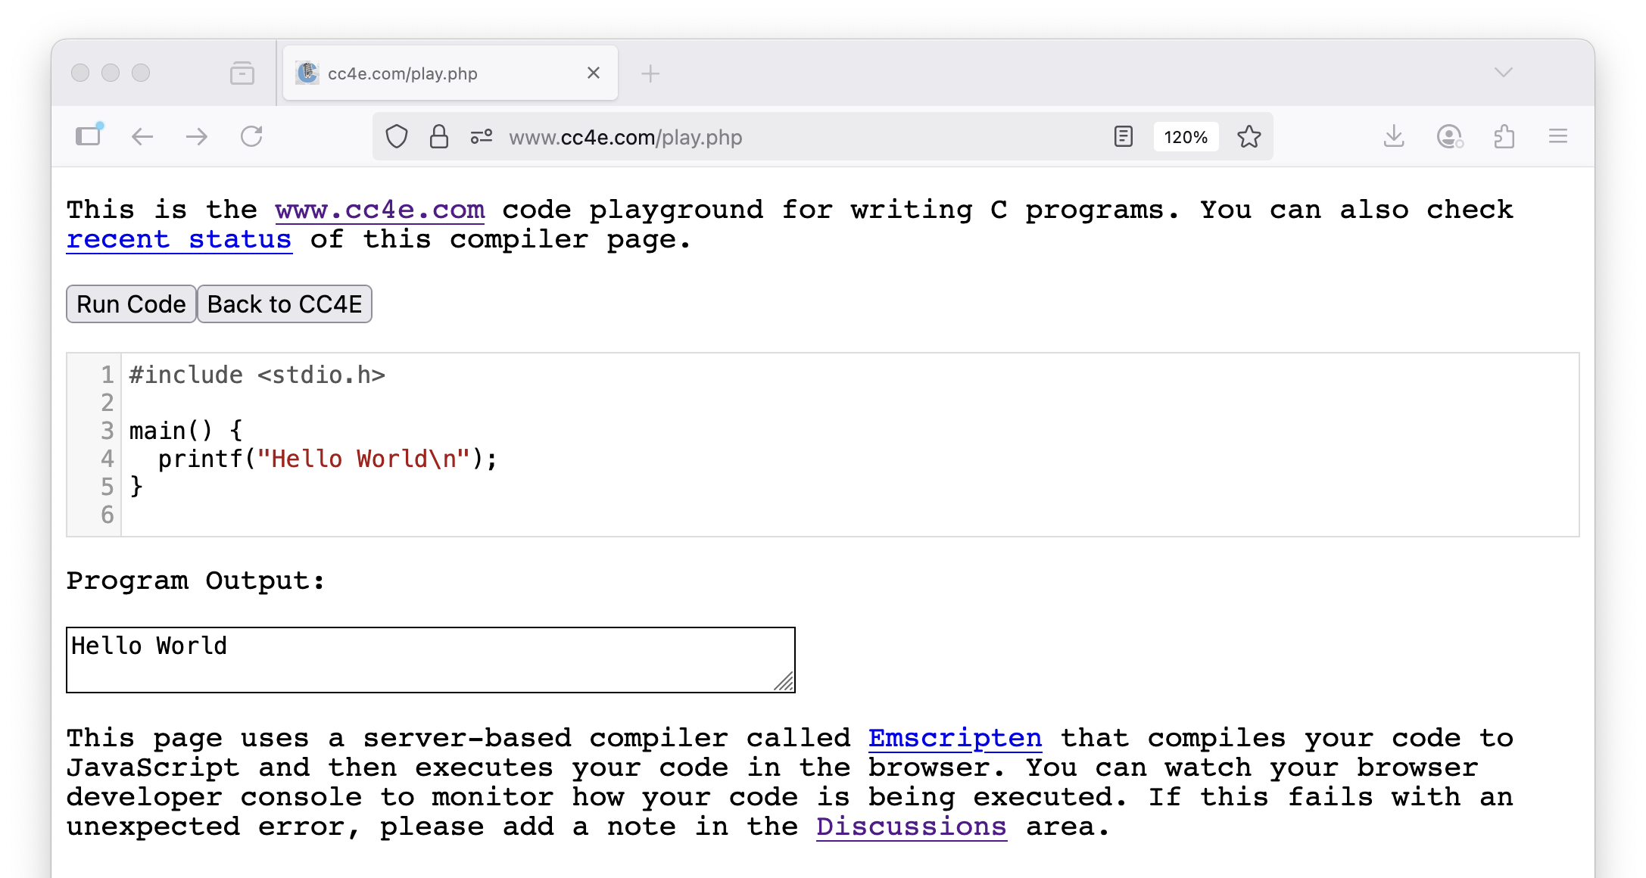

Slide 17
Programming Software
Compiler
Interpreter
Emulator
Virtualization

Slide 18
Compiler Phases

Slide 19
How CC4E works
Compiler (in the server) compiles C code to WASM
HTML page downloads WASM
The built in WASM emulator runs it in the browser

Slide 20
Python Runtime
Python
Kind of Hybrid for performance reasons
__pycache__ ( byte code)

Slide 21
JavaScript Runtime

Slide 22
Java Runtime
Traditional compiler to "byte code"
javac hello.java -> hello.class
Java virtual machine (JVM) runtime – byte code emulator
java hello.class
Just in time (JIT) compiler (a.k.a. Hotspot compiler)
JVM supports multiple languages
Scala …

Slide 23
PHP runtime

Slide 24
Interpreter

Slide 25
Virtualization

Slide 26
Virtualization
Modern CPUs have support for virtualization
CP/CMS
Parallels on Mac and Windows
Vmware
Docker
VirtualBox (Oracle)

Slide 27
Summary
TBD

Slide 28
Acknowledgements / Contributions
These slides are Copyright 2025- Charles R. Severance (online.dr-chuck.com) as part of www.ca4e.com and made available under a Creative Commons Attribution 4.0 License. Please maintain this last slide in all copies of the document to comply with the attribution requirements of the license. If you make a change, feel free to add your name and organization to the list of contributors on this page as you republish the materials.
Initial Development: Charles Severance, University of Michigan School of Information
Insert new Contributors and Translators here including names and dates
Continue new Contributors and Translators here

